Slide 2

Week 9: Team Building Techniques
1
Notes:
[Sources] - Text/content adapted exclusively from the uploaded chapter: Burke, R. & Barron, S. (2014). Project Management Leadership: Building Creative Teams, 2nd ed., Chapter 16 “Team-Building Techniques”. Source file: CHAPTER 16- Team-Building Techniques.docx - Background image: Unsplash direct image result for team meeting (https://images.unsplash.com/photo-1568992688065-536aad8a12f6...) [/Sources]

Slide 3

Learning outcomes
By then end of this session, you will be able to
Understand how team-building techniques can be used to accelerate the team-building process.
Understand the four levels of team building.
Understand that outdoor team-building activities can be used to develop interpersonal relationships and team roles.
Note: This session will begin with the task from last week—students presenting on AI.
2
Notes:
[Sources] - Text/content adapted exclusively from the uploaded chapter: Burke, R. & Barron, S. (2014). Project Management Leadership: Building Creative Teams, 2nd ed., Chapter 16 “Team-Building Techniques”. Source file: CHAPTER 16- Team-Building Techniques.docx - Background image: Unsplash direct image result for team meeting (https://images.unsplash.com/photo-1624555130581-1d9cca783bc0...) [/Sources]

Slide 4
Team Activity on AI
In your team, assess how AI is changing the world of work. What does this mean for your career aspirations and plans?
You will be required to present your findings at the start of next week’s session. Each person from the team is required to present to the class. If you are unable to attend the class, you will need to upload your work to Blackboard (one-page Word document, PdF or PowerPoint slide).
2
Notes:
[Sources] - Text/content adapted exclusively from the uploaded chapter: Burke, R. & Barron, S. (2014). Project Management Leadership: Building Creative Teams, 2nd ed., Chapter 16 “Team-Building Techniques”. Source file: CHAPTER 16- Team-Building Techniques.docx - Background image: Unsplash direct image result for team meeting (https://images.unsplash.com/photo-1624555130581-1d9cca783bc0...) [/Sources]

Slide 5
“Bringing a number of people together to perform a task does not necessarily mean they will work together effectively as a team—even when complementary skills, balanced personalities and a common goal are present”.
1. What is team building?
Team Building: “Activities designed to improve interpersonal relationships and increase team cohesiveness”.
It is also important to encourage information communication and activities because of their role in building trust and establishing good working relationships.
Team building enables a diverse group to work together effectively as a unit to achieve the project’s goals.
People often view the project through the lens of their own discipline and background.
The project manager must help individuals see the big picture and focus on overall project goals together.
Obtaining team spirit and commitment is what team building is all about.
Historical note
In the late 1980s and 1990s, many companies recognized team building as important for service quality and competitive advantage—yet the term often still felt nebulous in practice.
3
Notes:
[Sources] - Text/content adapted exclusively from the uploaded chapter: Burke, R. & Barron, S. (2014). Project Management Leadership: Building Creative Teams, 2nd ed., Chapter 16 “Team-Building Techniques”. Source file: CHAPTER 16- Team-Building Techniques.docx - Background image: Unsplash direct image result for team meeting (https://images.unsplash.com/photo-1568992688065-536aad8a12f6...) [/Sources]

Slide 6
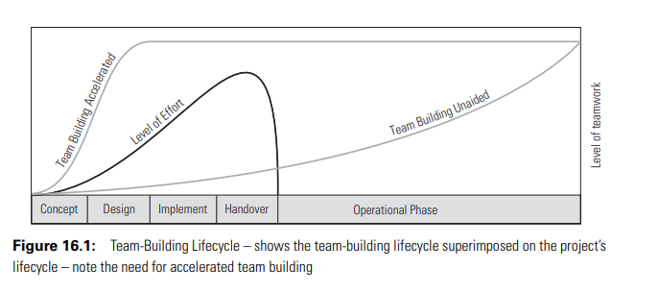
1
Notes:
[Sources] - Text/content adapted exclusively from the uploaded chapter: Burke, R. & Barron, S. (2014). Project Management Leadership: Building Creative Teams, 2nd ed., Chapter 16 “Team-Building Techniques”. Source file: CHAPTER 16- Team-Building Techniques.docx - Background image: Unsplash direct image result for team meeting (https://images.unsplash.com/photo-1568992688065-536aad8a12f6...) [/Sources]

Slide 7
Why team building must be accelerated
Interpretation of previous chart
Natural team building does occur as people work toward a common goal.
For short-duration projects, natural development is usually too slow and too ad hoc to be valuable.
The project manager should use team-building techniques as soon as the team is formed.
The chapter’s central point: the fully operational team must be made to happen.
Team building unaided
Accelerated team building raises the level of teamwork earlier in the project lifecycle.
4
Notes:
[Sources] - Text/content adapted exclusively from the uploaded chapter: Burke, R. & Barron, S. (2014). Project Management Leadership: Building Creative Teams, 2nd ed., Chapter 16 “Team-Building Techniques”. Source file: CHAPTER 16- Team-Building Techniques.docx - Background image: Unsplash direct image result for team meeting (https://images.unsplash.com/photo-1624555130581-1d9cca783bc0...) [/Sources]

Slide 8
Four levels of team building
Framework
Level One
Level Two
Level Three
Level Four
Interpersonal
team building
Team roles
Shared vision
Task focused
Members get to know each other, build trust and begin team cohesion.
Members identify preferred roles, understand expectations and see how they fit the team.
The team converges on one direction, one plan, one build method and one execution strategy.
The team improves efficiency and productivity through project-focused practice and skills.
Relationships → role clarity → shared direction → project performance
5
Notes:
[Sources] - Text/content adapted exclusively from the uploaded chapter: Burke, R. & Barron, S. (2014). Project Management Leadership: Building Creative Teams, 2nd ed., Chapter 16 “Team-Building Techniques”. Source file: CHAPTER 16- Team-Building Techniques.docx - Background image: Unsplash direct image result for team meeting (https://images.unsplash.com/photo-1568992688065-536aad8a12f6...) [/Sources]

Slide 9
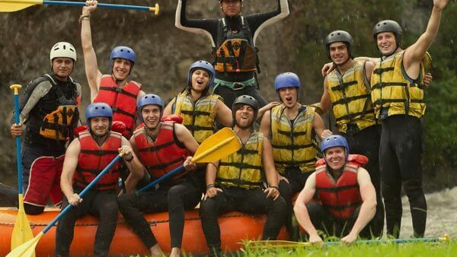
Level One
Interpersonal
Team Building
Project manager’s role at this level
Encourage members to talk to each other.
Help them learn one another’s backgrounds, work experiences, hobbies, interests, music and tastes.
Create situations where talking and listening can build interpersonal bonds and trust.
The first level focuses on team members simply getting to know each other—and, under work pressure, that does not always happen naturally.
Why it matters
Better understanding of personalities and behaviour improves communication and becomes the first step toward team cohesion.
6
Notes:
[Sources] - Text/content adapted exclusively from the uploaded chapter: Burke, R. & Barron, S. (2014). Project Management Leadership: Building Creative Teams, 2nd ed., Chapter 16 “Team-Building Techniques”. Source file: CHAPTER 16- Team-Building Techniques.docx - Background image: Company Away Days outdoor adventure image (https://www.companyawaydays.com/images/activities/category/outdoor-adventure.jpg) [/Sources]

Slide 10
Level One in practice
How interpersonal team building should be designed
Interaction before work focus
Design principles for activities
Expected outcomes
Exercises do not need to be work orientated; it is better if they are not.
Tasks should require a team effort and be interesting, challenging, mildly risky, enjoyable and memorable.
The risks should be more imaginary than actual—taking people out of their comfort zone is usually enough.
Outdoor activities provide an excellent environment; tasks should be competitive and may include trivial awards.
Members become more aware of each other and build friendship and trust.
They become more willing to accept constructive criticism because it is seen as work focused, not personal.
They are more willing to ask each other for help in solving problems and achieving tasks.
A shared experience creates a feeling of togetherness and can be referred to later in casual conversation.
Sessions are best held away from work to remove distractions: Outward Bound-type courses are ideal, and after-work social gatherings should also be encouraged.
7
Notes:
[Sources] - Text/content adapted exclusively from the uploaded chapter: Burke, R. & Barron, S. (2014). Project Management Leadership: Building Creative Teams, 2nd ed., Chapter 16 “Team-Building Techniques”. Source file: CHAPTER 16- Team-Building Techniques.docx - Background image: Company Away Days outdoor adventure image (https://www.companyawaydays.com/images/activities/category/outdoor-adventure.jpg) [/Sources]

Slide 11
3. Level Two: Team roles
Clarifying how each member fits into the project team
Role clarity
Emphasis
Adventure exercises at Level Two
The second level focuses on the team roles each member plays within the team.
A team role is defined as the type of work a person is expected to perform on the project.
Psychometric tests and interviews are used to determine each member’s personal team-role profile.
The Belbin model outlines nine team roles, expressed as preferred and non-preferred roles.
Tasks are designed to require multiple inputs and multiple interactions from all members.
External observers monitor interactions, behaviours and the team roles played during the activity.
Feedback sessions compare observed behaviour with preferred and non-preferred roles from psychometric tests.
This helps members see themselves as others see them, which may differ from personal perceptions.
“
The main value of team-role definitions lies in helping members see how they fit into the team—like cogs in a wheel, or pieces in a jigsaw puzzle.
8
Notes:
[Sources] - Text/content adapted exclusively from the uploaded chapter: Burke, R. & Barron, S. (2014). Project Management Leadership: Building Creative Teams, 2nd ed., Chapter 16 “Team-Building Techniques”. Source file: CHAPTER 16- Team-Building Techniques.docx - Background image: Unsplash direct image result for team meeting (https://images.unsplash.com/photo-1624555130581-1d9cca783bc0...) [/Sources]

Slide 12
Level Two tools and Belbin’s principles
From role feedback to a better balanced team
Belbin focus
Role-development discussion
Belbin’s five principles for building an effective team
Each member identifies their preferred team role.
Each member identifies what others can do to enhance personal effectiveness.
This is subdivided into: do more or better; do less or stop; carry on doing.
Members then discuss their lists and negotiate trade-offs: “I will do this if you do that.”
Roles
Each member contributes both a functional and a team role.
Balance
A team needs an optimal balance between functional and team roles depending on its task.
Strengths
Effectiveness depends on how far members identify and adjust to relative strengths within the team.
Personality
Some members fit some roles better than others, depending on personalities and mental abilities.
Outcome intended
Technical resources
Technical resources are best deployed when the team has a suitable range and balance of roles.
Clarified expectations make it easier to deploy relative strengths and improve personal effectiveness inside the team.
9
Notes:
[Sources] - Text/content adapted exclusively from the uploaded chapter: Burke, R. & Barron, S. (2014). Project Management Leadership: Building Creative Teams, 2nd ed., Chapter 16 “Team-Building Techniques”. Source file: CHAPTER 16- Team-Building Techniques.docx - Background image: Unsplash direct image result for team meeting (https://images.unsplash.com/photo-1624555130581-1d9cca783bc0...) [/Sources]

Slide 13
Group activity 2
Level One: Plan a level one team-building event to enable the team members to get to know each other.
2. Level Two: Plan a level two team-building event to enable the team members to identify and develop their individual team roles
2
Notes:
[Sources] - Text/content adapted exclusively from the uploaded chapter: Burke, R. & Barron, S. (2014). Project Management Leadership: Building Creative Teams, 2nd ed., Chapter 16 “Team-Building Techniques”. Source file: CHAPTER 16- Team-Building Techniques.docx - Background image: Unsplash direct image result for team meeting (https://images.unsplash.com/photo-1624555130581-1d9cca783bc0...) [/Sources]

Slide 14

4. Level Three: Shared vision
Converging on one direction for the project
Alignment
At this point members may know each other and understand their team roles, yet still interpret the project differently.
Different interpretations may concern corporate vision requirements, the business case, the project plan, the build method and the execution strategy.
If so, members can still be pulling in different directions.
Inputs the chapter says may diverge
Corporate
vision
Business
case
Build
method
Execution
strategy
Shared vision
Project manager’s responsibility
Encourage the team to air views, opinions and perceptions, then discuss, confront and negotiate until they converge on an optimal and shared vision.
Links this level to storming and norming: effective
performance requires one direction, one project plan, one build
method and one execution strategy.
10
Notes:
[Sources] - Text/content adapted exclusively from the uploaded chapter: Burke, R. & Barron, S. (2014). Project Management Leadership: Building Creative Teams, 2nd ed., Chapter 16 “Team-Building Techniques”. Source file: CHAPTER 16- Team-Building Techniques.docx - Background image: Unsplash direct image result for whiteboard presentation (https://images.unsplash.com/photo-1758873269108-7c03a92f7586...) [/Sources]

Slide 15
5. Level Four: Task focused
Improving efficiency and productivity through project-centred practice
Performance
The fourth level focuses on how team members will carry out the project and improve team performance.
Discussion begins with the project, its purpose and how to achieve it: the project plan, build method and execution strategy.
At this level the project manager assumes shared goals, no interpersonal issues and no hidden agendas—those have already been ironed out.
Exercises now focus on technical skills and competencies applied individually and together as a team.
Skills training the chapter lists
WBS
Quantify scope of work
CPM / Gantt charts
Calculate time schedules
QCP
Determine quality standards
Problem solving
Solve problems
Analogy
Decision making
Make decisions
Like a football team’s practice session: players rehearse moves and tactics that require several people to work closely together.
Critics’ view
Some critics dismiss levels one to three because they are not project focused; they do value level four because its emphasis is directly on improving performance.
11
Notes:
[Sources] - Text/content adapted exclusively from the uploaded chapter: Burke, R. & Barron, S. (2014). Project Management Leadership: Building Creative Teams, 2nd ed., Chapter 16 “Team-Building Techniques”. Source file: CHAPTER 16- Team-Building Techniques.docx - Background image: Unsplash direct image result for whiteboard presentation (https://images.unsplash.com/photo-1758873269108-7c03a92f7586...) [/Sources]

Slide 16
Group activity 2
3. Level Three: Plan a level three team-building event to enable the team members to establish a shared and common team objective.
4. Level Four: Plan a level four team-building event to enable
the team members to improve the team’s operating effi ciency.
2
Notes:
[Sources] - Text/content adapted exclusively from the uploaded chapter: Burke, R. & Barron, S. (2014). Project Management Leadership: Building Creative Teams, 2nd ed., Chapter 16 “Team-Building Techniques”. Source file: CHAPTER 16- Team-Building Techniques.docx - Background image: Unsplash direct image result for team meeting (https://images.unsplash.com/photo-1624555130581-1d9cca783bc0...) [/Sources]

Slide 17
6. Outdoor Team Building
Why management
team building?
Military comparison
Before action, soldiers have already been through shared experiences together—cold, wet, hungry and exhausted.
These shared experiences reinforce cooperation and teamwork.
The outdoor environment provides adventurous activities for management team building—and, when combined with management education, personal interaction, rest and relaxation, it offers the best of all worlds.
Industry and commerce contrast
Industry often conducts team building on the job, after the work or project has already started.
That creates risk: poor interaction, interpersonal conflict, poor problem solving, poor decision making and poor teamwork all carry a cost to the company.
Outdoor team building is presented as one way to fast-track the team-building process.
12
Notes:
[Sources] - Text/content adapted exclusively from the uploaded chapter: Burke, R. & Barron, S. (2014). Project Management Leadership: Building Creative Teams, 2nd ed., Chapter 16 “Team-Building Techniques”. Source file: CHAPTER 16- Team-Building Techniques.docx - Background image: Company Away Days outdoor adventure image (https://www.companyawaydays.com/images/activities/category/outdoor-adventure.jpg) [/Sources]

Slide 18
6.2 Why outdoor team building?
From theory to live interaction
Traditional management training
Management skills can be tested and developed
Lectures, reading, discussions, examples and assignments teach theory and knowledge.
Case studies improve conceptual thinking, problem solving and decision making.
But these methods fail to create a real-life dynamic situation: there is no live interaction and no real risk.
Interaction and teamwork skills
Competitive skills
Problem-solving skills
Decision-making skills
Communication skills
Leadership skills
Outdoor courses add what is missing
Outdoor pursuits become the training vehicle for real-life, interactive, problem-based learning with immediate feedback on performance.
Following skills
Settings listed in the chapter include the sea, mountains and game parks; activities mentioned include golf, sailing and mountaineering.
13
Notes:
[Sources] - Text/content adapted exclusively from the uploaded chapter: Burke, R. & Barron, S. (2014). Project Management Leadership: Building Creative Teams, 2nd ed., Chapter 16 “Team-Building Techniques”. Source file: CHAPTER 16- Team-Building Techniques.docx - Background image: Company Away Days outdoor adventure image (https://www.companyawaydays.com/images/activities/category/outdoor-adventure.jpg) [/Sources]

Slide 19
6.3 Outdoor action learning
outdoor education vs. mere outdoor adventure
Learning-by-doing
For outdoor adventure to be educational, it must be part of an integrated program with frequent opportunities for reflection.
This is what distinguishes outdoor adventure from outdoor education.
The physical event should be secondary to the primary activity: learning about team building, leadership, communication and problem solving.
Members must accept responsibility and accountability for instructions delegated to fellow team members.
Most effective learning process described in the chapter
Reflect
Carry out
a task
Discuss
Analyse &
evaluate
People seldom learn from experience unless they assess it and assign their own meaning. The chapter adds that people often learn more from mistakes than from successes.
14
Notes:
[Sources] - Text/content adapted exclusively from the uploaded chapter: Burke, R. & Barron, S. (2014). Project Management Leadership: Building Creative Teams, 2nd ed., Chapter 16 “Team-Building Techniques”. Source file: CHAPTER 16- Team-Building Techniques.docx - Background image: Company Away Days outdoor adventure image (https://www.companyawaydays.com/images/activities/category/outdoor-adventure.jpg) [/Sources]

Slide 20
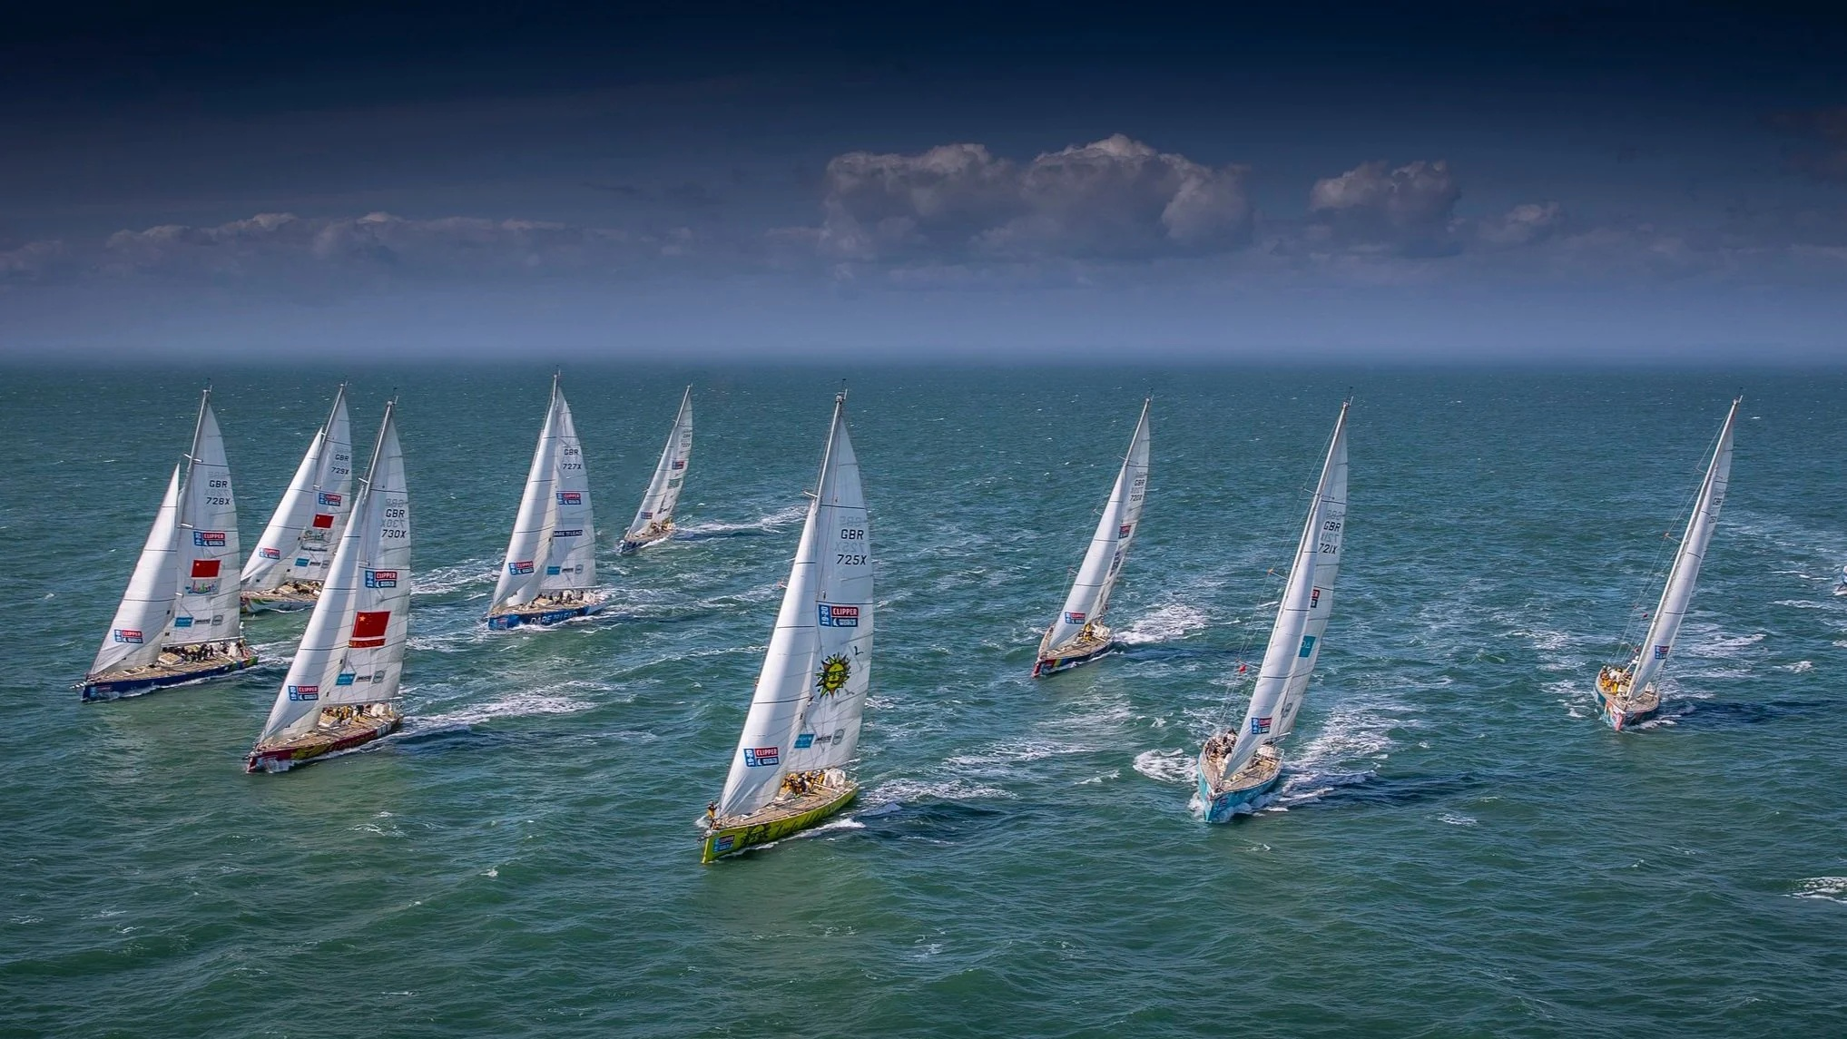
6.4 Why go sailing?
Sailing as the chapter’s featured outdoor team-building vehicle
Applied outdoor environment
Once the yacht leaves the dock, the crew is on its own and isolated; members cannot simply walk away when they have had enough.
The sense of apparent danger heightens awareness, and success or failure depends on the team’s own devices.
Sailing offers interaction and competition between teams, both of which are central features of team building.
What sailing demonstrates
A manoeuvre like tacking succeeds only when several people coordinate actions at the same time.
Racing heightens interaction because failure lets the side down.
The active environment allows management theories from the classroom to be tried and tested immediately.
On return to the training base, discussion sessions let delegates review the day’s exercises and relate management principles back to work.
Examples
Tacking
Sail changes
Anchoring
Man-over-board recovery
Yacht racing against other crews
Conclusion on sailing
Sailing offers “learning-by-doing” with others who are also learning-by-doing—the chapter calls this the only sure way of knowing that team members can work together effectively as a team.
15
Notes:
[Sources] - Text/content adapted exclusively from the uploaded chapter: Burke, R. & Barron, S. (2014). Project Management Leadership: Building Creative Teams, 2nd ed., Chapter 16 “Team-Building Techniques”. Source file: CHAPTER 16- Team-Building Techniques.docx - Background image: Clipper Race fleet image (https://images.squarespace-cdn.com/.../Clipper2019-20RaceFleet.jpg) [/Sources]

Slide 21
Group Activity 3
Imagine your boat has sunk, you are stranded in the ocean. Rank the following items from MOST important (1) to LEAST important (10) for survival. You must agree as a team — not individually:
Mirror
Water container
RopeCompass
First aid kit
Food rations
Plastic sheet
Radio
Knife
Life jacket
Who leads
Who stays quiet
How decisions are made
Conflict or cooperation?
2
Notes:
[Sources] - Text/content adapted exclusively from the uploaded chapter: Burke, R. & Barron, S. (2014). Project Management Leadership: Building Creative Teams, 2nd ed., Chapter 16 “Team-Building Techniques”. Source file: CHAPTER 16- Team-Building Techniques.docx - Background image: Unsplash direct image result for team meeting (https://images.unsplash.com/photo-1624555130581-1d9cca783bc0...) [/Sources]

Slide 22

CHAPTER 17
References
• Burke, R. and Barron, S., 2014. Project management leadership: Building creative teams. 2nd ed. Farnham: Gower Publishing.
Further readings;
Kouzes, J. M., & Posner, B. Z. (2023). The leadership challenge: How to make extraordinary things happen in organizations (7th ed.). John Wiley & Sons.
Meredith, J. R., Shafer, S. M., & Mantel, S. J., Jr. (2017). Project management: A managerial approach (10th ed.). John Wiley & Sons.
“
04
Notes:
[Sources] - Based exclusively on the attached source: Burke, R. and Barron, S. (2014) “Chapter 17: Coaching and Mentoring” in Project Management Leadership: Building Creative Teams, 2nd ed., Farnham: Gower Publishing. File: CHAPTER17 - Coaching and Mentoring.docx. [/Sources]

Slide 23

Any Questions or comments?
01
Notes:
[Sources] - Burke, R. and Barron, S. (2014). Project Management Leadership: Building Creative Teams, 2nd ed. Farnham: Gower Publishing. Chapter 14: Team Roles. User-supplied chapter. [/Sources]

